Slide 1

Hybrid App Development using Ionic Framework

Slide 2
WHO ?
We are from KOFIX TECHNOLOGIES RESOURCES
Focusing on professional IT training and project development
Consist of very passionate and committed people to help you to code and achieve business success

Slide 3

Education:
Self-taught coders
Certified Ethical Hacker (V8)
Mobile App Developer
Android Native Using Java
Ionic Hybrid App
Web App Developer
Laravel PHP Framework 5.4
Front end Developer
Data Science (focus on modelling, ML)
Computer Vision using Deep learning
Working Experience:
Data Scientist @ AirAsia Bhd
CEO Kofix Technologies Resources
CTO Trippal Sdn Bhd
Internship in J Studio Kreatif as Programmer
Web Developer for Maibasuh
Muhammad Nazmi Bin Mat Asri
Undergraduate, Bachelor Degree of ICT

Slide 4
COURSE DESCRIPTION
In this course, we will focus on Ionic Framework and Cordova, which complement each other to create a strong mobile application.
We will have 5 projects, where I will explain and demonstrate to you on:
Implementing local storage for long term data storage
Notification alert
Accessing contact list
Authentication: Sign up, sign in, logout features
Geolocation: Google maps and real time location app

Slide 5
WHAT YOU SHOULD KNOW
It’s better if you know (since this no longer introductory class):
HTML
CSS
AngularJS
MVC (Model View Controller)

Slide 6
PROJECT OVERVIEW
Implementing local storage for long term data storage
Notification alert
Accessing contact list
Authentication: Sign up, sign in, logout features
Geolocation: Google maps and real time location app

Slide 7
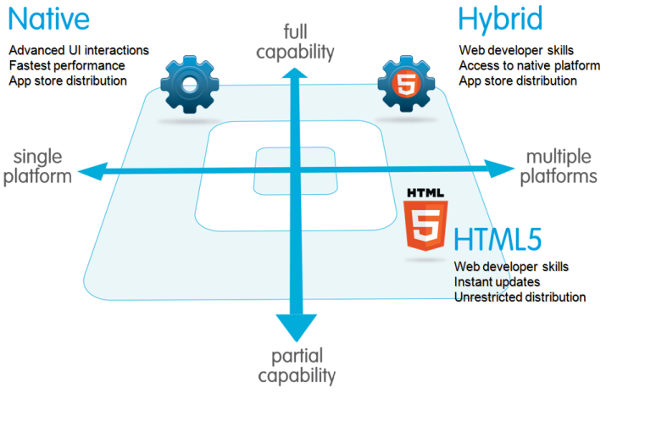
TYPES OF MOBILE APP
Web Application
Native Application
Hybrid Application

Slide 8
WHAT IS IONIC?
Front-end framework to develop hybrid mobile apps
HTML5 + AngularJS
Build for both iOS and Android platforms

Slide 9
Software needed for Ionic Framework:
Sublime Text 3: Modern Text Editor (Personal Recommendation)
NodeJS: https://nodejs.org/en/
Java JDK: http://www.oracle.com/technetwork/java/javase/downloads/jdk-netbeans-jsp-142931.html
Android SDK: https://developer.android.com/studio/index.html
Set ANDROID_HOME
Set PATH
5. Ionic Framework and Cordova: npm install –g cordova ionic

Slide 10
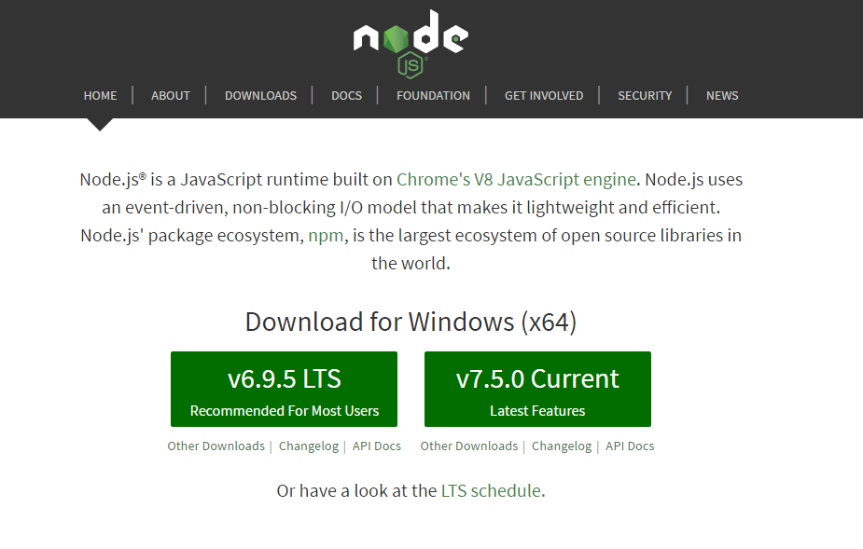

Slide 11
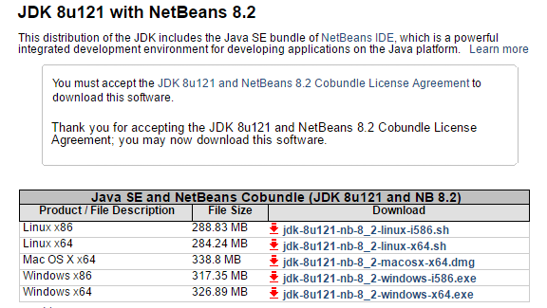

Slide 12
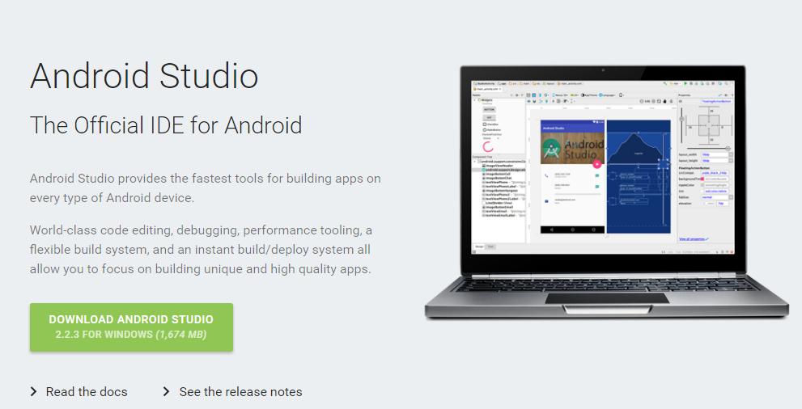

Slide 13
AngularJS
Javascript framework for building dynamic web application
Extends HTML with directives
Ionic built with AngularJS, so at least you need to know the fundamental (we will go through after this)

Slide 14
Cordova / Phonegap
Allow us to build cross platform hybrid apps
Single code base (one code, compile to all supported platform)
Provide native functionalities to our HTML CSS JS
Access to phone API

Slide 15
Running Ionic
ionic start project-name blank
ionic serve –lab
ionic platform add android
ionic build android
ionic emulate android
*iOS only if you use Apple Mac

Slide 16
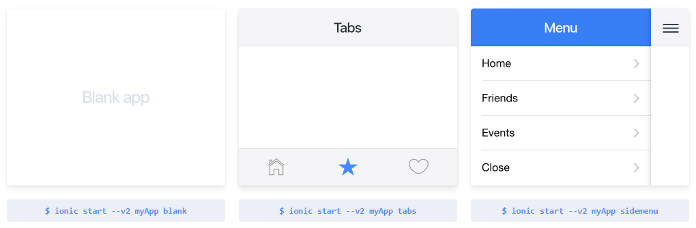
Starter kit

Slide 17

AngularJS Fundamental
Directives
Data Binding
Modules
Controllers
Services

Slide 18
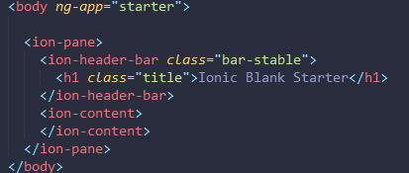
Directives
Directive – declarative HTML
It’s a custom HTML Tag

Slide 19

Data Binding
2-way data binding, linked to each other
Imagine the concept of variable

Slide 20

Modules
It’s like a ‘core’ of app, and can be used to group several object
Used to organize objects which used in the angular application

Slide 21
Controller
Communicate with the view/templates to display data
Only use controller to add behavior to ‘$scope’ object
$scope – link view to the controller

Slide 22
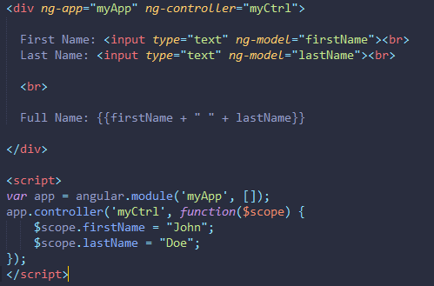

Slide 23
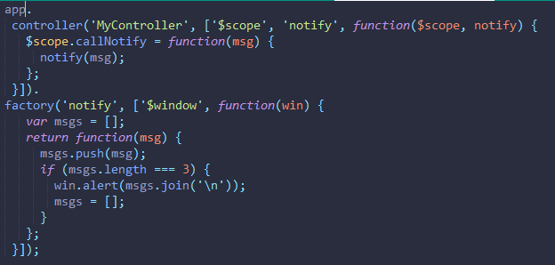
Services
A function which is built to make it available to your application
Example: $location, $http (built-in always start with ‘$’)
Lazily Instantiated, Singleton

Slide 24
Project 1: Local Storage
https://github.com/gsklee/ngStorage

Slide 25
Project 2: Notification
https://github.com/katzer/cordova-plugin-local-notifications
http://ngcordova.com/docs/plugins/localNotification/

Slide 26
Project 3: Accessing Contact List
http://ngcordova.com/docs/plugins/contacts/

Slide 27
Project 4: Authentication with Firebase
https://firebase.google.com/docs/auth/
https://firebase.google.com/products/auth/

Slide 28
Project 5: Geolocation
https://github.com/apache/cordova-plugin-geolocation

Slide 29
Thank You

